Slide 1
CN:CST31209: Deep Learning and Big Data Intelligence
JING WEN
Spring 2022
Lecture 7: object detection and segmentation

Slide 2
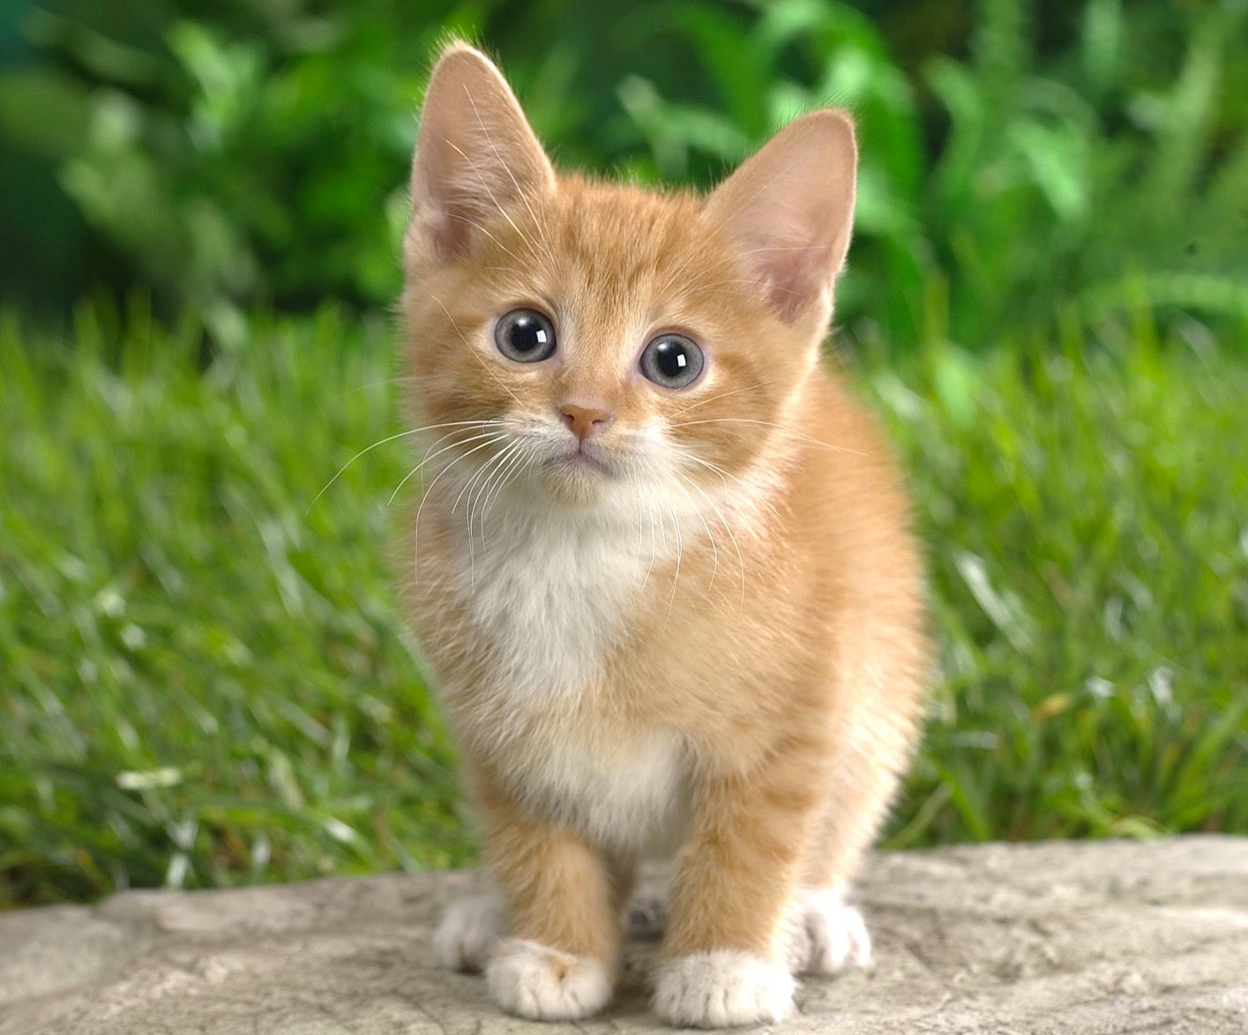
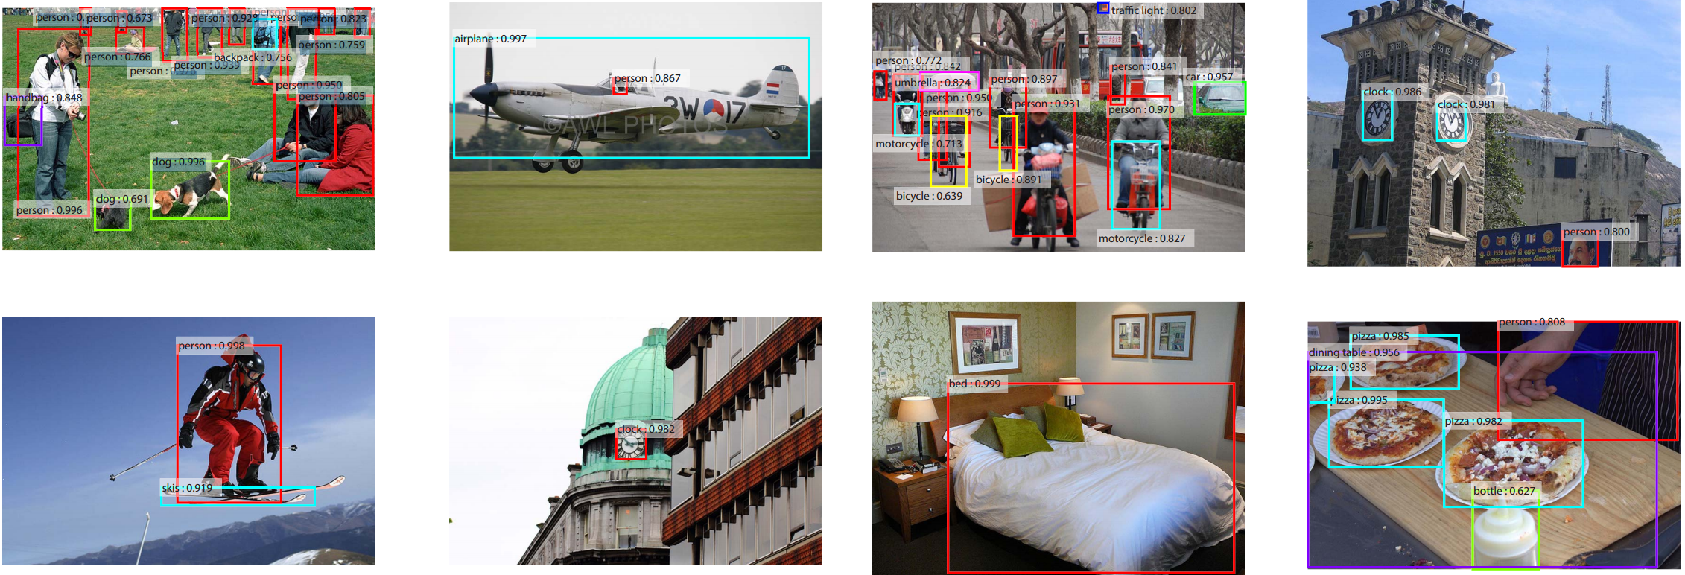
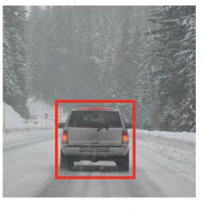
Localization and Detection
Location detection
Results from Faster R-CNN, Ren et al 2015

Slide 3
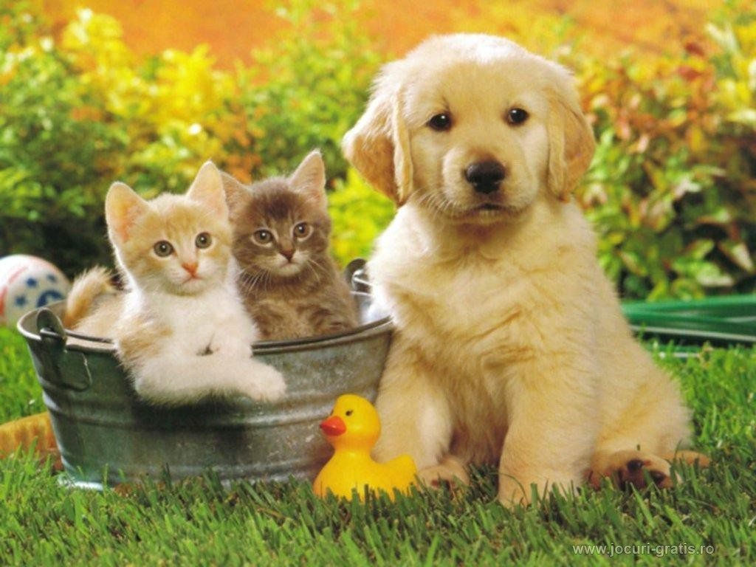
Computer Vision Tasks
Classification
Classification + Localization
Object Detection
Instance Segmentation
CAT
CAT
CAT, DOG, DUCK
CAT, DOG, DUCK
Single object
Multiple objects

Slide 4
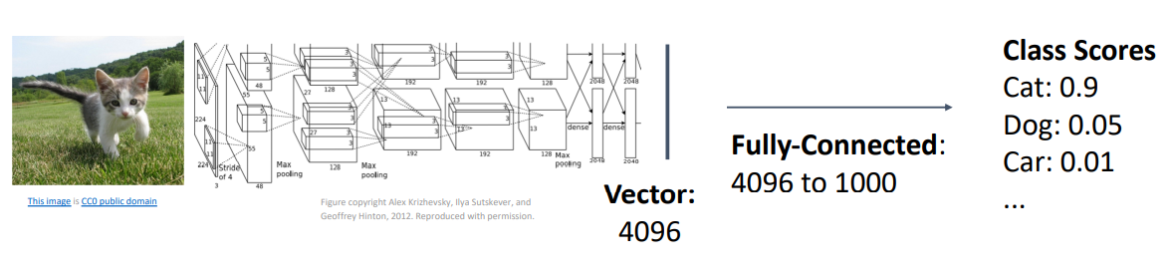
Computer Vision Tasks

Slide 5
Computer Vision Tasks
Classification
Classification + Localization
Object Detection
Instance Segmentation

Slide 6
Classification + Localization: Task
Classification: C classes
Input: Image
Output: Class label
Evaluation metric: Accuracy
Localization:
Input: Image
Output: Box in the image (x, y, w, h)
Evaluation metric: Intersection over Union
Classification + Localization: Do both
CAT
(x, y, w, h)

Slide 7
Idea #1: Localization as Regression
Input: image
(0,0)
Neural Net
Output: Box coordinates
(4 numbers)
(bx,by,bw,bh)
Loss:
L2 distance
Correct output: box coordinates
(4 numbers)
(1,1)
Only one object, simpler than detection

Slide 8
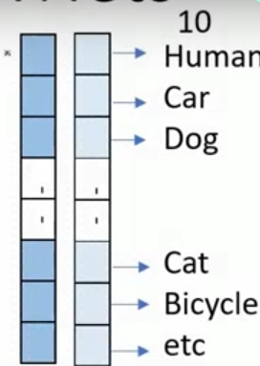
Simple Recipe for Classification + Localization
Step 1: Train (or download) a classification model (AlexNet, VGG, GoogLeNet)
Convolution
and Pooling
Fully-connected layers
Softmax loss
Final conv feature map
Class scores
Image

Slide 9
Simple Recipe for Classification + Localization
Step 2: Attach new fully-connected “regression head” to the network
Fully-connected layers
“Classification head”
Convolution
and Pooling
Class scores
Fully-connected layers
“Regression head”
Final conv feature map
Image
Box coordinates

Slide 10
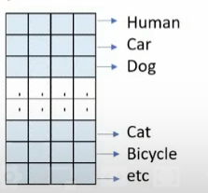
Simple Recipe for Classification + Localization
Step 3: Train the regression head only with SGD and L2 loss
Fully-connected layers
Convolution
and Pooling
Class scores
Fully-connected layers
L2 loss
Final conv feature map
Image
Box coordinates

Slide 11
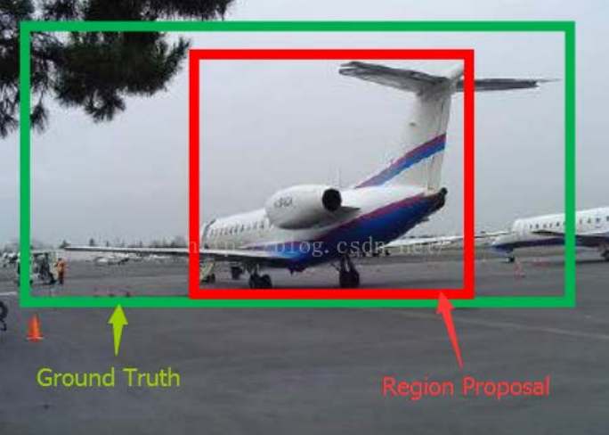
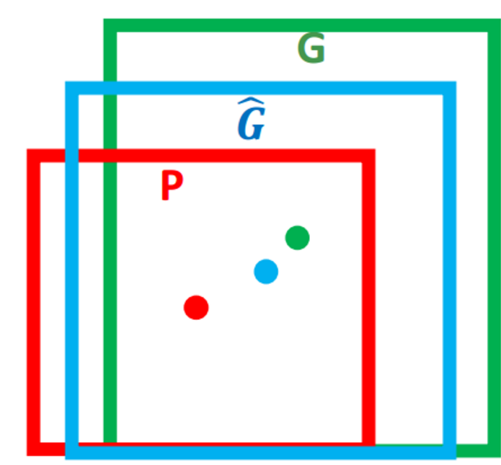
Bounding-box regression
Ground Truth
Proposal
平移，尺度缩放

Slide 12
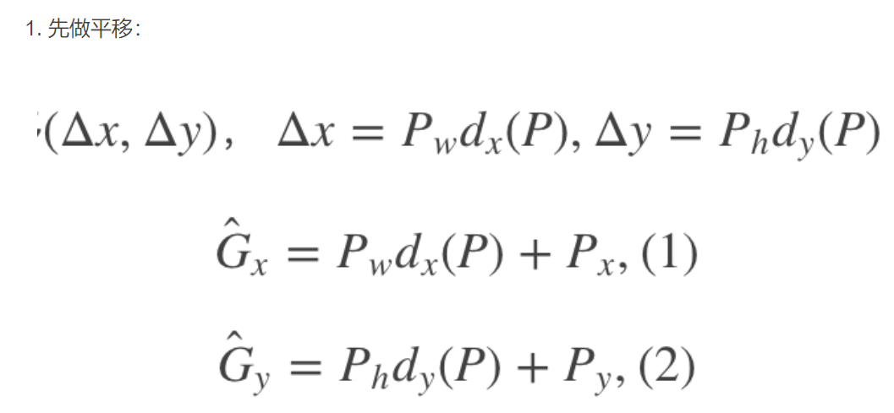
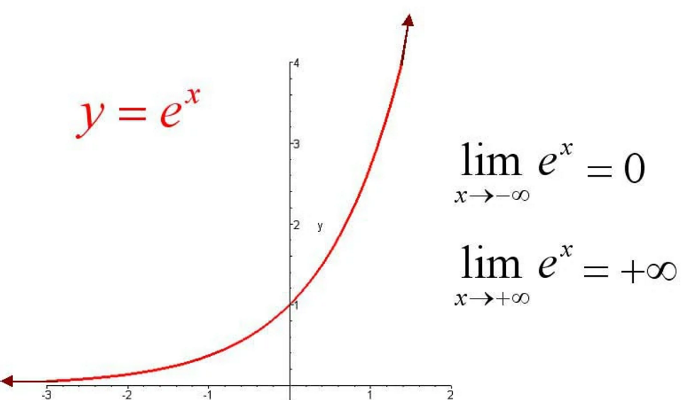
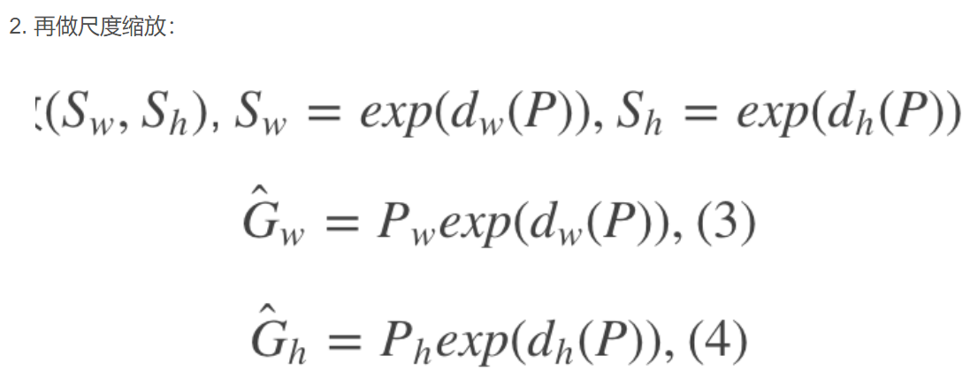

Slide 13
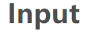


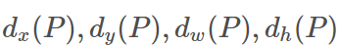
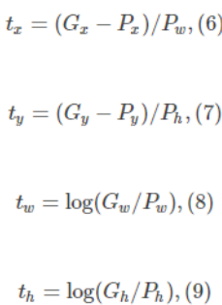

Slide 14
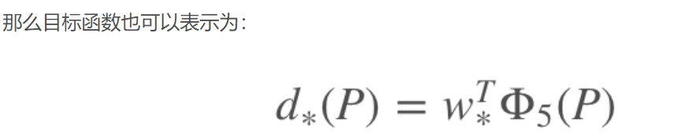
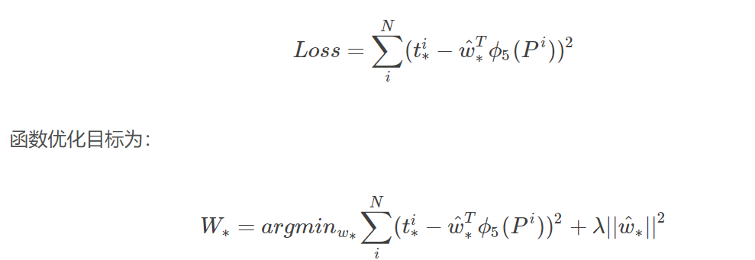

Slide 15
Simple Recipe for Classification + Localization
Step 4: At test time use both heads
Fully-connected layers
Convolution
and Pooling
Class scores
Fully-connected layers
Final conv feature map
Image
Box coordinates

Slide 16
Per-class vs class agnostic regression
Assume classification over C classes:
Fully-connected layers
Classification head:
C numbers (one per class)
Convolution
and Pooling
Class scores
Class agnostic: 4 numbers
(one box)
Fully-connected layers
Class specific: C x 4 numbers
(one box per class)
Final conv feature map
Image
Box coordinates

Slide 17
Where to attach the regression head?
After conv layers:
Overfeat, VGG
After last FC layer:
DeepPose, R-CNN
Convolution
and Pooling
Fully-connected layers
Softmax loss
Final conv feature map
Class scores
Image

Slide 18
Aside: Localizing multiple objects
Want to localize exactly K objects in each image
(e.g. whole cat, cat head, cat left ear, cat right ear for K=4)
Fully-connected layers
Convolution
and Pooling
Class scores
Fully-connected layers
K x 4 numbers
(one box per object)
Final conv feature map
Image
Box coordinates

Slide 19
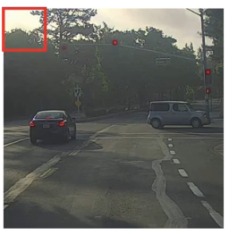
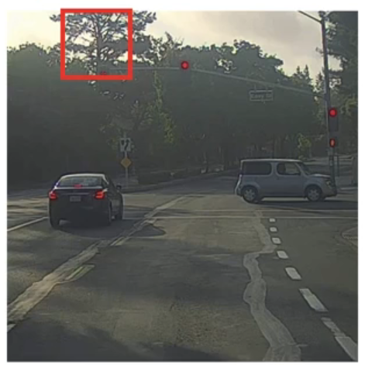
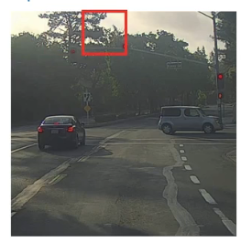
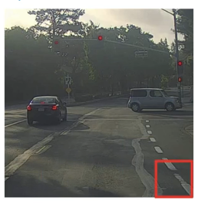
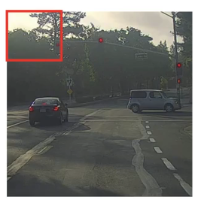
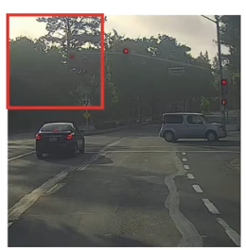
Sliding Windows detection
scale1
scale2
scale3
Notes:
Computational cost :
太多patch，卷积网络一个个处理，如果stride太大，可能丢失object，卷积神经网络兴起前一般用线性分类器进行分类

Slide 20
Sliding Window: Overfeat
Winner of ILSVRC 2013 localization challenge
一阶段目标检测，基于Alexnet
4096
4096
Class scores:
1000
FC
FC
Convolution + pooling
Softmax loss
5*5
FC
FC
Feature map: 1024 x 5 x 5
FC
FC
Image: 3 x 221 x 221
Euclidean
loss
1024
Boxes: 1000 x 4
Sermanet et al, “Integrated Recognition, Localization and Detection using Convolutional Networks”, ICLR 2014
4096

Slide 21
Efficient Sliding Window: Overfeat
Efficient sliding window by converting fully-connected layers into convolutions
Class scores: 1000 x 1 x 1
4096 x 1 x 1
1024 x 1 x 1
Convolution + pooling
1 x 1 conv
1 x 1 conv
5 x 5 conv
5 x 5 conv
Feature map: 1024 x 5 x 5
1 x 1 conv
1 x 1 conv
Image: 3 x 221 x 221
4096 x 1 x 1
1024 x 1 x 1
Box coordinates: (4 x 1000) x 1 x 1

Slide 22
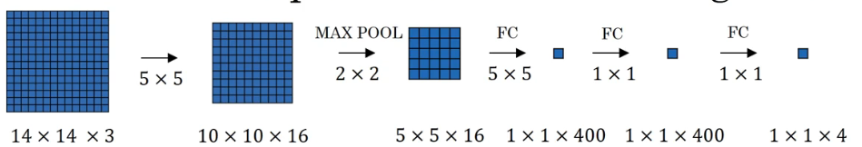
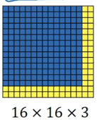
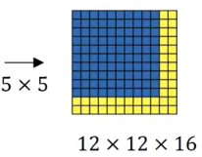
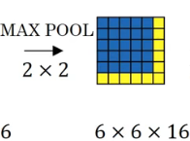
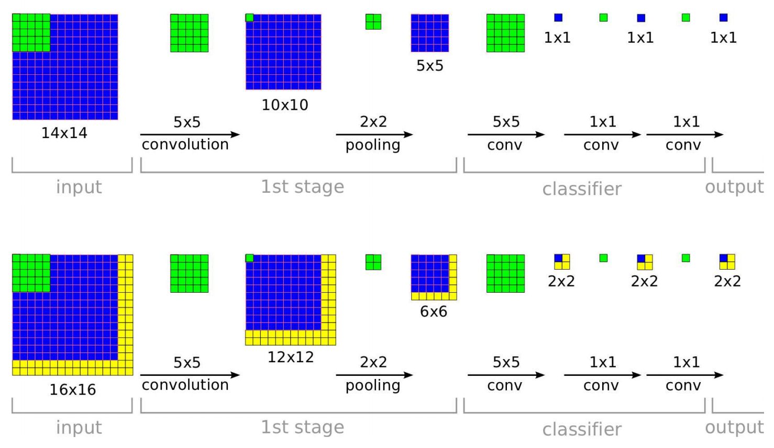
Notes:
第二行，一个的感受野是14*14，相当于左上角蓝色部分代表代表输入的左上角，右上角黄色代表输入的右上角。即可以并行得到每个滑动窗口的置信度。

Slide 23
Efficient Sliding Window: Overfeat
Training time: Small image, 1 x 1 classifier output
Test time: Larger image, 2 x 2 classifier output, only extra compute at yellow regions
Sermanet et al, “Integrated Recognition, Localization and Detection using Convolutional Networks”, ICLR 2014

Slide 24
Sliding Window: Overfeat
Network input: 3 x 221 x 221
Larger image: 3 x 257 x 257

Slide 25
Sliding Window: Overfeat
0.5
Network input: 3 x 221 x 221
Larger image: 3 x 257 x 257
Classification scores: P(cat)

Slide 26
Sliding Window: Overfeat
0.5 | 0.75
Network input: 3 x 221 x 221
Larger image: 3 x 257 x 257
Classification scores: P(cat)

Slide 27
Sliding Window: Overfeat
0.5 | 0.75
0.6
Network input: 3 x 221 x 221
Larger image: 3 x 257 x 257
Classification scores: P(cat)

Slide 28
Sliding Window: Overfeat
0.5 | 0.75
0.6 | 0.8
Network input: 3 x 221 x 221
Larger image: 3 x 257 x 257
Classification scores: P(cat)

Slide 29
Sliding Window: Overfeat
0.5 | 0.75
0.6 | 0.8
Network input: 3 x 221 x 221
Larger image: 3 x 257 x 257
Classification scores: P(cat)

Slide 30
Sliding Window: Overfeat
Greedily merge boxes and scores (details in paper)
0.8
Network input: 3 x 221 x 221
Larger image: 3 x 257 x 257
Classification score: P(cat)

Slide 31
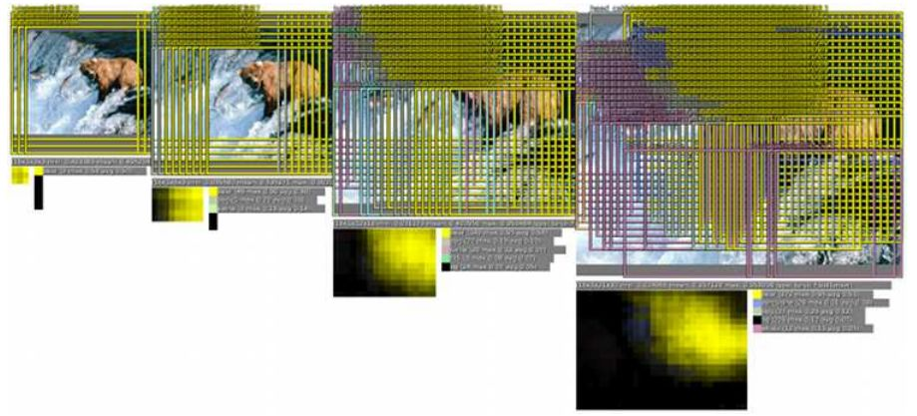
Sliding Window: Overfeat
Window positions + score maps

Slide 32
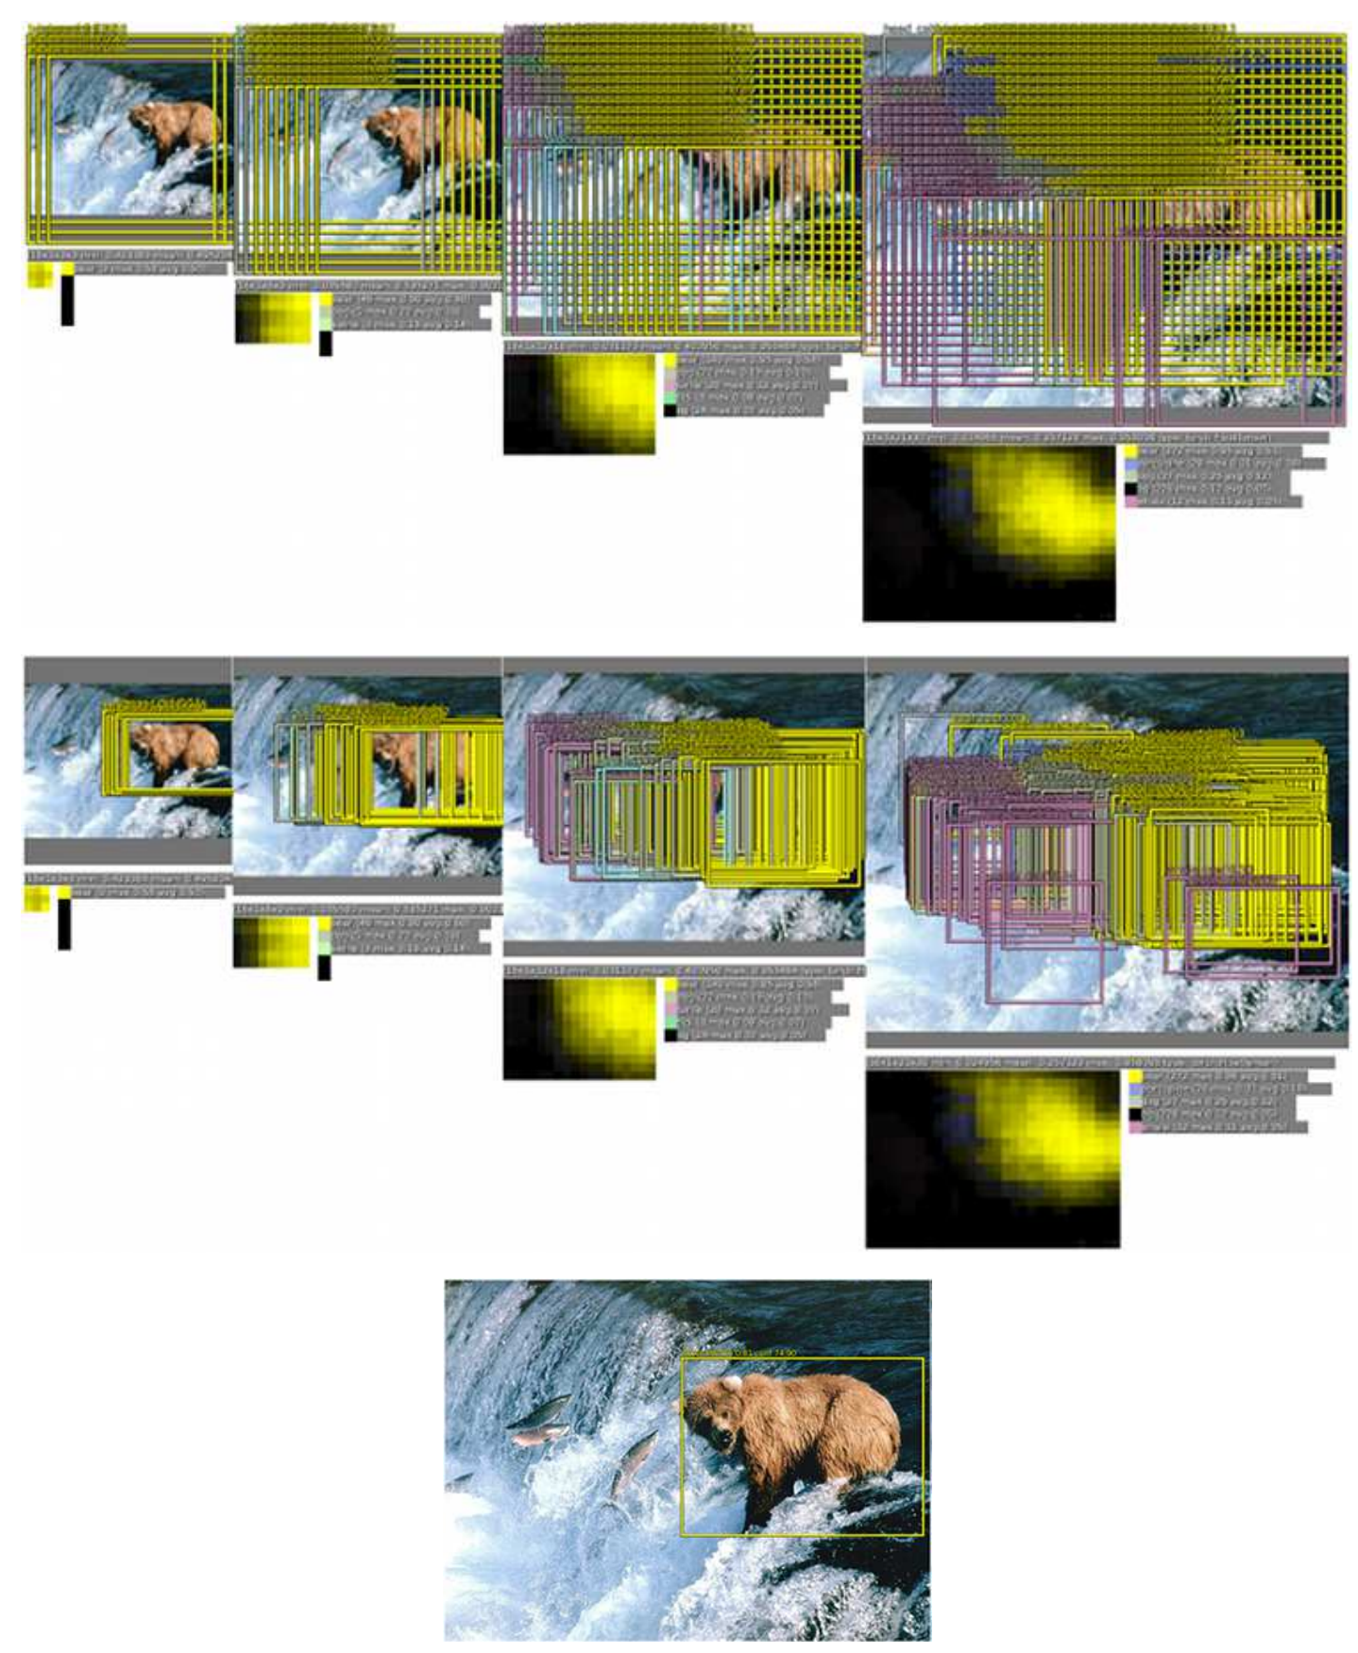
Sliding Window: Overfeat
Box regression outputs
Final Predictions
定位时，对每个尺度同时运行分类网络和回归网络。这样，分类网络给出类别的概率，回归网络为每个类预测一个bbox。这样对于每个bbox，就有一个置信度与之对应。
Sermanet et al, “Integrated Recognition, Localization and Detection using Convolutional Networks”, ICLR 2014

Slide 33
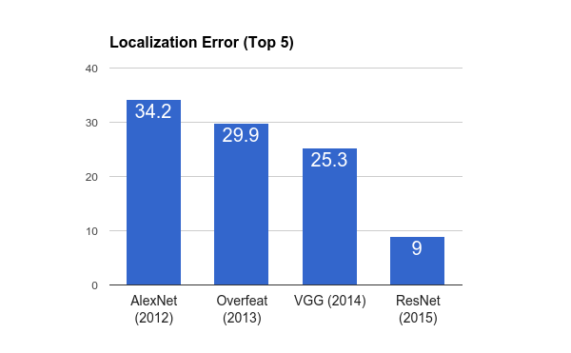
ImageNet Classification + Localization
AlexNet: Localization method not published
Overfeat: Multiscale convolutional regression with box merging
VGG: Same as Overfeat, but fewer scales and locations; simpler method, gains all due to deeper features
ResNet: Different localization method (RPN) and much deeper features

Slide 34
Computer Vision Tasks
Classification
Classification + Localization
Object Detection
Instance Segmentation

Slide 35
Computer Vision Tasks
Classification
Classification + Localization
Object Detection
Instance Segmentation

Slide 36
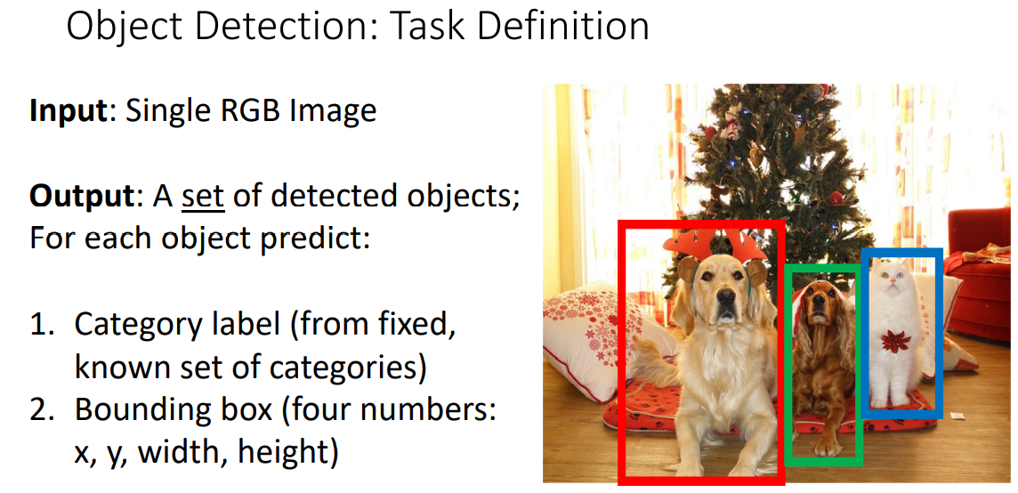

Slide 37
Detection as Regression?
DOG, (x, y, w, h)
CAT, (x, y, w, h)
CAT, (x, y, w, h)
DUCK (x, y, w, h) background
= 20 numbers

Slide 38

Detection as Regression?
DOG, (x, y, w, h)
CAT, (x, y, w, h) background
= 12 numbers

Slide 39
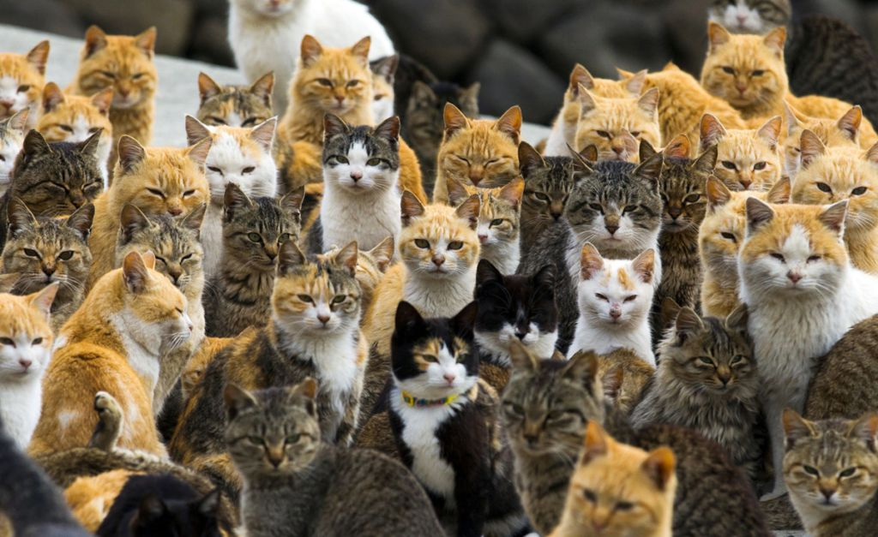
Detection as Regression?
CAT, (x, y, w, h)
CAT, (x, y, w, h)
….
CAT (x, y, w, h)
= many numbers
Need variable sized outputs

Slide 40
Detection as Classification
CAT? NO
DOG? NO
Background? No

Slide 41
Detection as Classification
CAT? YES!
DOG? NO
Background? No

Slide 42
Detection as Classification
CAT? NO
DOG? NO
Background? No

Slide 43
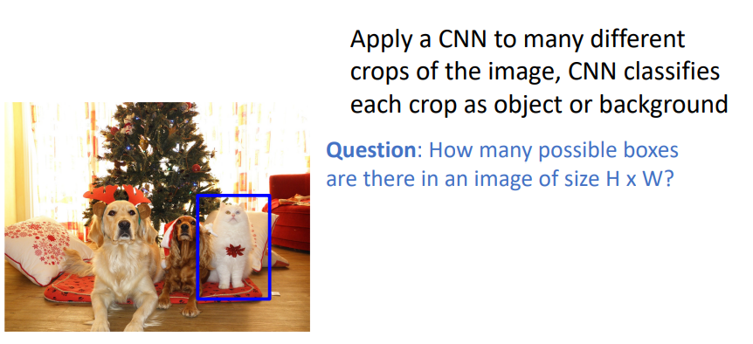
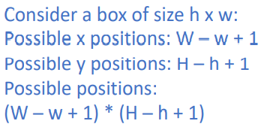
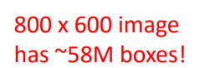
Detection as Classification
Problem: Need to test many positions and scales
Solution: If your classifier is fast enough, just do it

Slide 44
Detection as Classification
Problem: Need to test many positions and scales, and use a computationally demanding classifier (CNN)
Solution: Only look at a tiny subset of possible positions

Slide 45

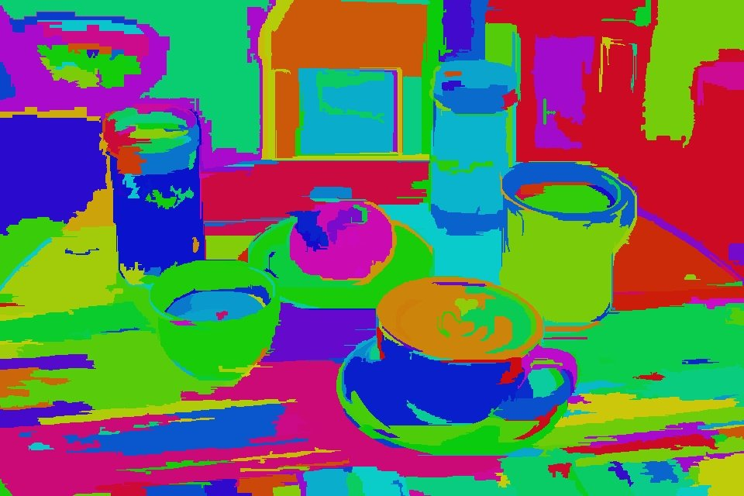
Region Proposals: Selective Search
Efficient Graph-Based Image Segmentation,IJCV 2004

Slide 46
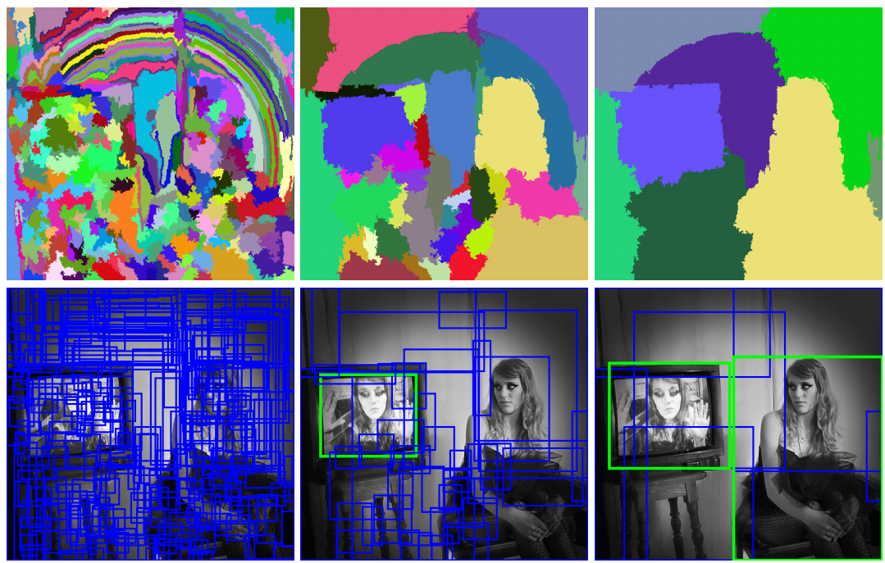
Region Proposals: Selective Search
Bottom-up segmentation, merging regions at multiple scales
Convert regions to boxes
Uijlings et al, “Selective Search for Object Recognition”, IJCV 2013
Notes:
1.首先将所有分割区域的外框加到候选区域列表中
2.基于相似度（颜色、纹理、尺寸和空间交叠）
合并一些区域
3.将合并后的分割区域作为一个整体，跳到步骤1

Slide 47
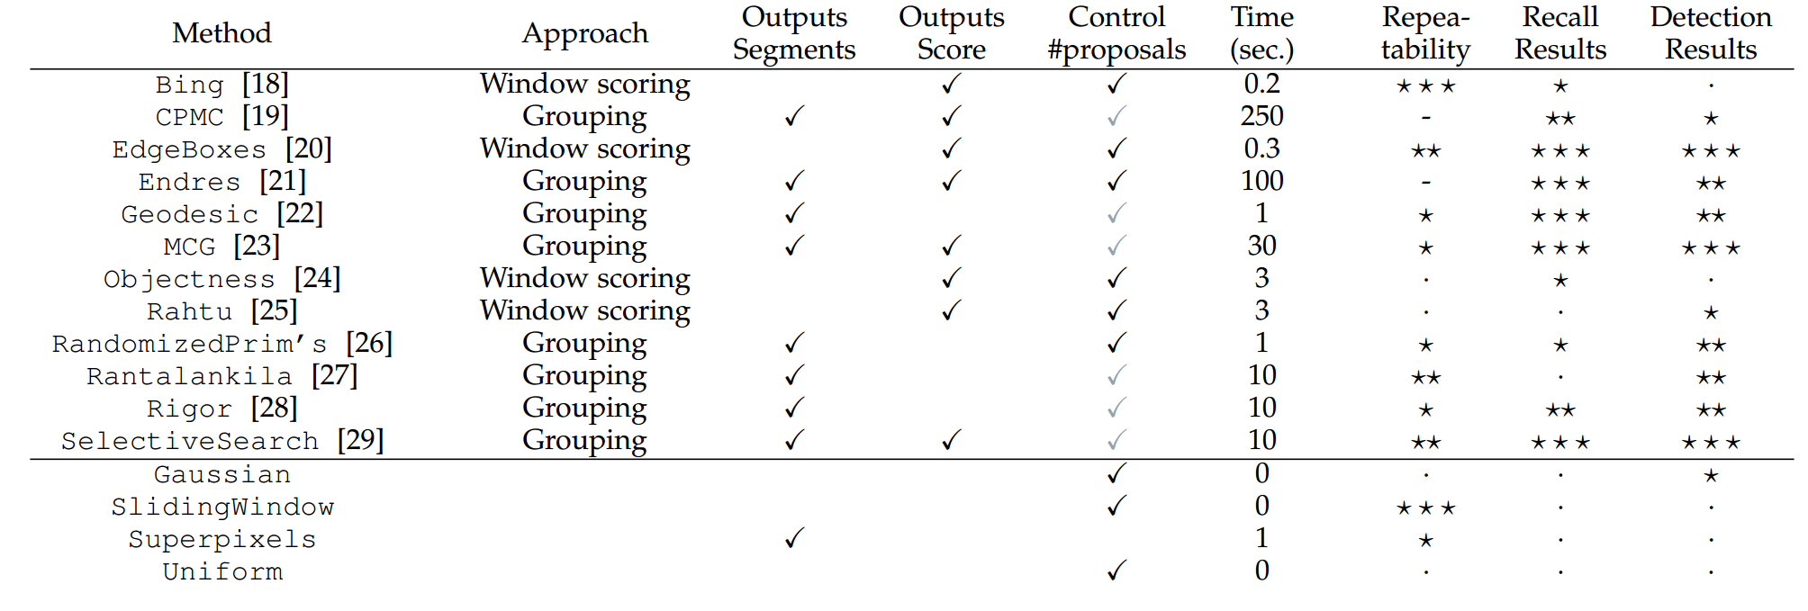
Region Proposals: Many other choices
Hosang et al, “What makes for effective detection proposals?”, PAMI 2015

Slide 48
Region Proposals: Many other choices
Hosang et al, “What makes for effective detection proposals?”, PAMI 2015

Slide 49
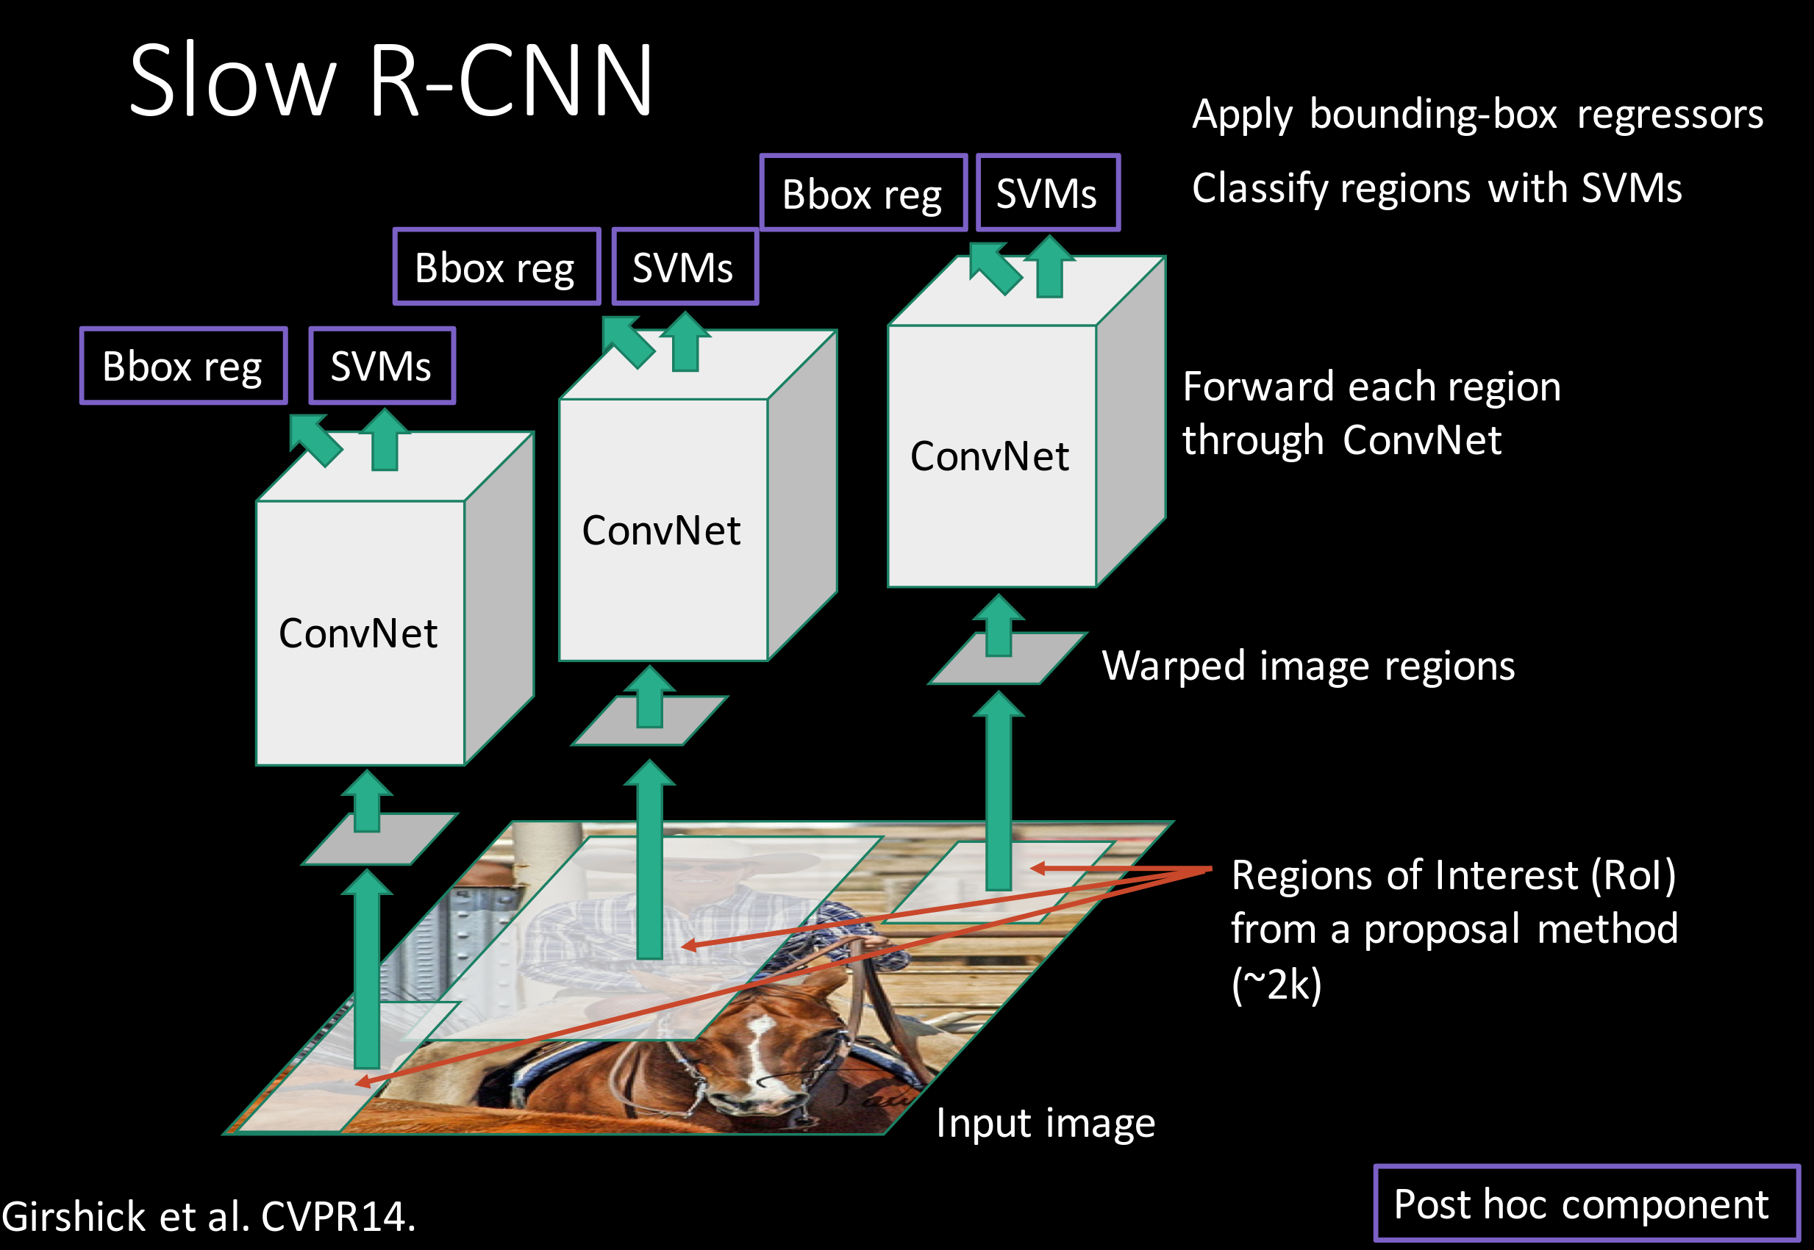
Putting it together: R-CNN
Girschick et al, “Rich feature hierarchies for accurate object detection and semantic segmentation”, CVPR 2014 Slide credit: Ross Girschick
Notes:
选2000个候选框，每类一个SVM二分类

Slide 50
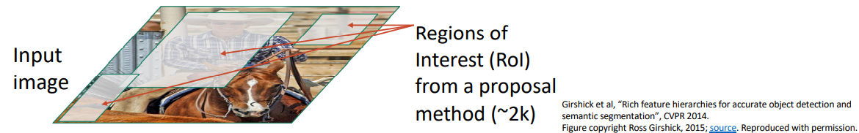
R-CNN: Region-Based CNN

Slide 51
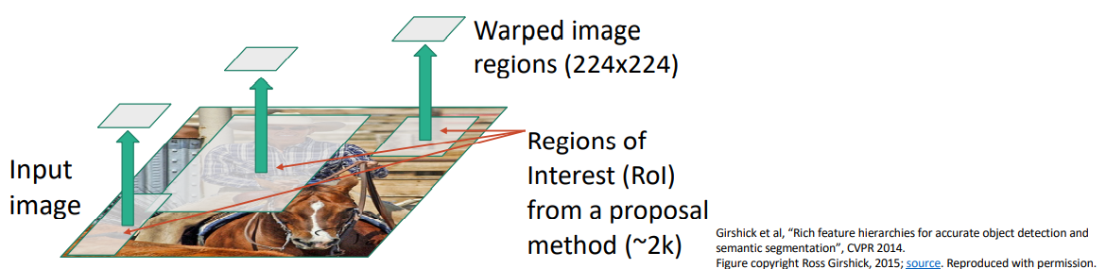
R-CNN: Region-Based CNN

Slide 52
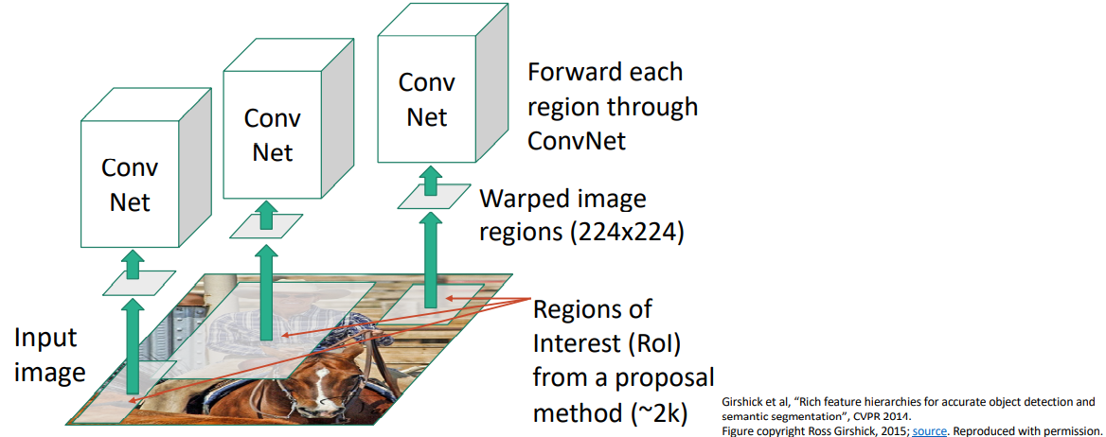
R-CNN: Region-Based CNN

Slide 53

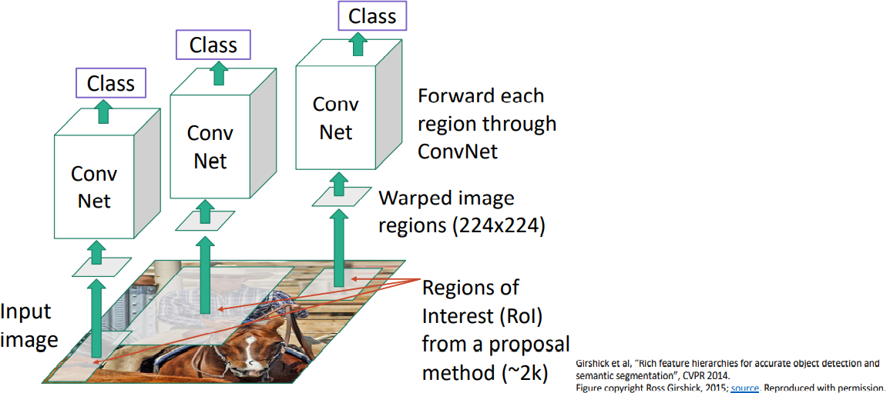
R-CNN: Region-Based CNN

Slide 54
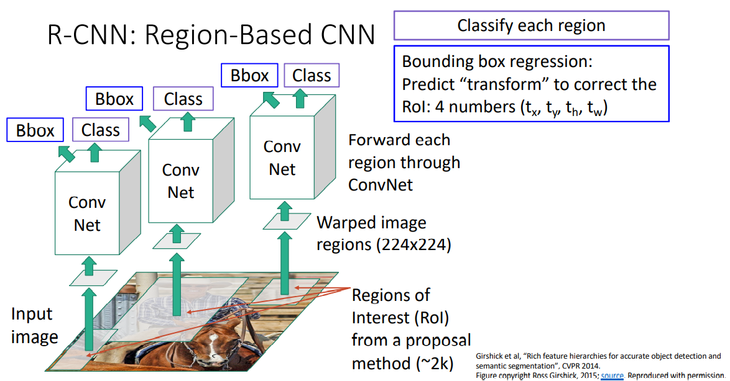

Slide 55
R-CNN Training
Step 1: Train (or download) a classification model for ImageNet (AlexNet)
Convolution
and Pooling
Fully-connected layers
Softmax loss
Final conv feature map
Class scores 1000 classes
Image

Slide 56
R-CNN Training
Step 2: Fine-tune model for detection
Instead of 1000 ImageNet classes, want 20 object classes + background
Throw away final fully-connected layer, reinitialize from scratch
Keep training model using positive / negative regions from detection images
Re-initialize this layer: was 4096 x 1000, now will be 4096 x 21
Convolution
and Pooling
Fully-connected layers
Softmax loss
Final conv feature map
Class scores: 21 classes
Image
Notes:
采用在 ImageNet 上已经训练好的模型，然后在 PASCAL VOC 数据
集上进行 fine-tune。

Slide 57
R-CNN Training
Step 3: Extract features
Extract region proposals for all images
For each region: warp to CNN input size, run forward through CNN, save pool5 features to disk
Have a big hard drive: features are ~200GB for PASCAL dataset!
Convolution
and Pooling
pool5 features
Image
Region Proposals
Crop + Warp
Forward pass
Save to disk

Slide 58
R-CNN Training
Step 4: Train one binary SVM per class to classify region features
Training image regions
Cached region features
Positive samples for cat SVM
Negative samples for cat SVM

Slide 59
R-CNN Training
Step 4: Train one binary SVM per class to classify region features
Training image regions
Cached region features
Positive samples for cat SVM
Negative samples for cat SVM

Slide 60
R-CNN Training
Step 5 (bbox regression): For each class, train a linear regression model to map from cached features to offsets to GT boxes to make up for “slightly wrong” proposals
Training image regions
Cached region features
Regression targets
(dx, dy, dw, dh)
Normalized coordinates
(0, 0, 0, 0) Proposal is good
(.25, 0, 0, 0) Proposal too far to left
(0, 0, -0.125, 0) Proposal too wide

Slide 61
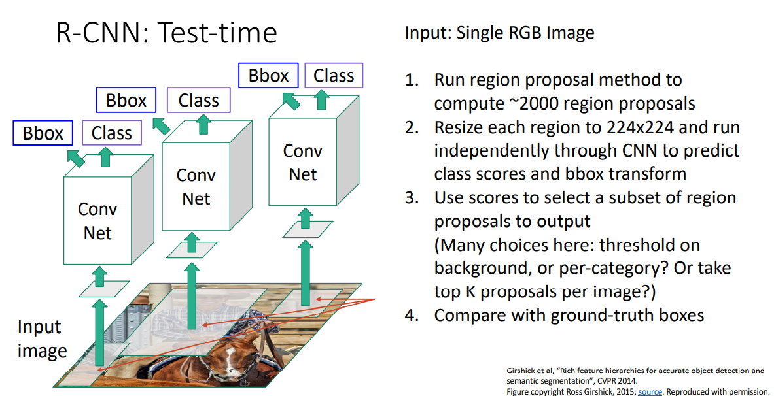
R-CNN Training

Slide 62
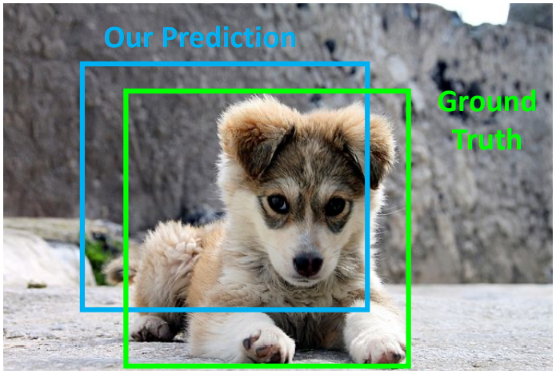
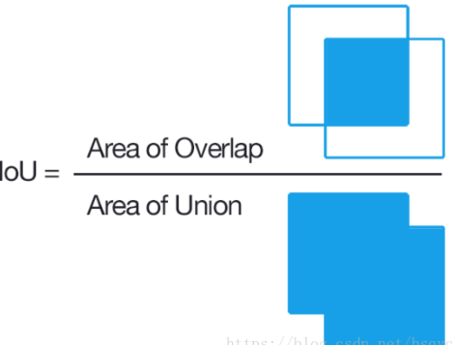
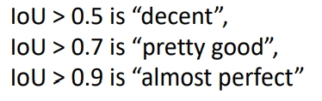
Compare Boxes：IOU

Slide 63
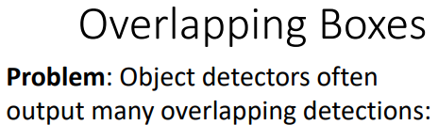


NMS（Non-Max Suppression）
Sort 0.95, 0.9, 0.9, 0.8, 0.7, 0.7
Discard IOU>0.6

Slide 64


NMS（Non-Max Suppression）

Slide 65
Object Detection: Datasets
 | PASCAL VOC (2010) | ImageNet Detection (ILSVRC 2014) | MS-COCO (2014)
Number of classes | 20 | 200 | 80
Number of images (train + val) | ~20k | ~470k | ~120k
Mean objects per image | 2.4 | 1.1 | 7.2

Slide 66
Object Detection: Evaluation
We use a metric called “mean average precision” (mAP)
Compute average precision (AP) separately for each class, then average over classes
A detection is a true positive if it has IoU with a ground-truth box greater than some threshold (usually 0.5) (mAP@0.5)
Combine all detections from all test images to draw a precision / recall（查准率/查全率） curve for each class; AP is area under the curve
TL;DR mAP is a number from 0 to 100; high is good

Slide 67

Object Detection: Evaluation-PR曲线

Slide 68


Object Detection: Evaluation-PR曲线

Slide 69



Object Detection: Evaluation-PR曲线

Slide 70


Object Detection: Evaluation-PR曲线

Slide 71


Object Detection: Evaluation-PR曲线

Slide 72


Object Detection: Evaluation-PR曲线

Slide 73



Slide 74



Slide 75

R-CNN Results
Wang et al, “Regionlets for Generic Object Detection”, ICCV 2013

Slide 76
R-CNN Results
Big improvement compared to pre-CNN methods

Slide 77
R-CNN Results
Bounding box regression helps a bit

Slide 78
R-CNN Results
Features from a deeper network help a lot

Slide 79
R-CNN Problems
Slow at test-time: need to run full forward pass of CNN for each region proposal
SVMs and regressors are post-hoc: CNN features not updated in response to SVMs and regressors
Complex multistage training pipeline

Slide 80

Fast R-CNN
Girschick, “Fast R-CNN”, ICCV 2015 Slide credit: Ross Girschick

Slide 81

Fast R-CNN
Solution: Share computation of convolutional layers between proposals for an image
R-CNN Problem #1: Slow at test-time due to independent forward passes of the CNN

Slide 82

Fast R-CNN

Slide 83

Fast R-CNN

Slide 84

Fast R-CNN
R-CNN Problem #2: Post-hoc training: CNN not updated in response to final classifiers and regressors
R-CNN Problem #3:
Complex training pipeline
Solution:
Just train the whole system end-to-end all at once!
Slide credit: Ross Girschick

Slide 85
Fast R-CNN: Region of Interest Pooling
Convolution
and Pooling
Fully-connected layers
Hi-res input image:
3 x 800 x 600 with region proposal
Hi-res conv features:
C x H x W with region proposal
Problem: Fully-connected layers expect low-res conv features: C x h x w

Slide 86
Fast R-CNN: Region of Interest Pooling
Project region proposal onto conv feature map
Convolution
and Pooling
Fully-connected layers
Hi-res input image:
3 x 800 x 600 with region proposal
Hi-res conv features:
C x H x W with region proposal
Problem: Fully-connected layers expect low-res conv features: C x h x w

Slide 87
Fast R-CNN: Region of Interest Pooling
Convolution
and Pooling
Divide projected region into h x w grid
Fully-connected layers
Hi-res input image:
3 x 800 x 600 with region proposal
Hi-res conv features:
C x H x W with region proposal
Problem: Fully-connected layers expect low-res conv features: C x h x w

Slide 88
Fast R-CNN: Region of Interest Pooling
Max-pool within each grid cell
Convolution
and Pooling
Fully-connected layers
Hi-res input image:
3 x 800 x 600 with region proposal
Hi-res conv features:
C x H x W with region proposal
RoI conv features:
C x h x w for region proposal
Fully-connected layers expect low-res conv features: C x h x w

Slide 89

Fast R-CNN: Region of Interest Pooling

Slide 90
Fast R-CNN: Region of Interest Pooling
Can back propagate similar to max pooling
Convolution
and Pooling
Fully-connected layers
Hi-res input image:
3 x 800 x 600 with region proposal
Hi-res conv features:
C x H x W with region proposal
RoI conv features:
C x h x w for region proposal
Fully-connected layers expect low-res conv features: C x h x w

Slide 91
Fast R-CNN: Region of Interest Pooling
5 | 3 | 16 | 7
2 | 1 | 5 | 4
7 | 8 | 4 | 9
5 | 9 | 2 | 5
5 | 3 | 2
2 | 1 | 9
5 | 9 | 4

Slide 92
Fast R-CNN: Region of Interest Pooling
5 | 3 | 16 | 7
2 | 1 | 5 | 4
7 | 8 | 4 | 9
5 | 9 | 2 | 5
5
5 | 3 | 2
2 | 1 | 9
5 | 9 | 4

Slide 93
Fast R-CNN: Region of Interest Pooling
5 | 3 | 16 | 7
2 | 1 | 5 | 4
7 | 8 | 4 | 9
5 | 9 | 2 | 5
5 | 16
5 | 3 | 2
2 | 1 | 9
5 | 9 | 4

Slide 94
Fast R-CNN: Region of Interest Pooling
5 | 3 | 16 | 7
2 | 1 | 5 | 4
7 | 8 | 4 | 9
5 | 9 | 2 | 5
5 | 16
9
5 | 3 | 2
2 | 1 | 9
5 | 9 | 4
5 | 9
9 | 4

Slide 95
Fast R-CNN: Region of Interest Pooling
5 | 3 | 16 | 7
2 | 1 | 5 | 4
7 | 8 | 4 | 9
5 | 9 | 2 | 5
5 | 16
9 | 9
5 | 3 | 2
2 | 1 | 9
5 | 9 | 4

Slide 96
Fast R-CNN: Region of Interest Pooling
5 | 3 | 16 | 7
2 | 1 | 5 | 4
7 | 8 | 4 | 9
5 | 9 | 2 | 5
5 | 16
9 | 9
5 | 3 | 2
2 | 1 | 9
5 | 9 | 4
5

Slide 97
Fast R-CNN: Region of Interest Pooling
5 | 3 | 16 | 7
2 | 1 | 5 | 4
7 | 8 | 4 | 9
5 | 9 | 2 | 5
5 | 16
9 | 9
5 | 3 | 2
2 | 1 | 9
5 | 9 | 4
5 | 9

Slide 98
Fast R-CNN: Region of Interest Pooling
5 | 3 | 16 | 7
2 | 1 | 5 | 4
7 | 8 | 4 | 9
5 | 9 | 2 | 5
5 | 16
9 | 9
5 | 3 | 2
2 | 1 | 9
5 | 9 | 4
5 | 9
9

Slide 99
Fast R-CNN: Region of Interest Pooling
5 | 3 | 16 | 7
2 | 1 | 5 | 4
7 | 8 | 4 | 9
5 | 9 | 2 | 5
5 | 16
9 | 9
5 | 3 | 2
2 | 1 | 9
5 | 9 | 4
5 | 9
9 | 4

Slide 100
Fast R-CNN Results
 | R-CNN | Fast R-CNN
Training Time: | 84 hours | 9.5 hours
(Speedup) | 1x | 8.8x
Faster!
Using VGG-16 CNN on Pascal VOC 2007 dataset

Slide 101
Fast R-CNN Results
 | R-CNN | Fast R-CNN
Training Time: | 84 hours | 9.5 hours
(Speedup) | 1x | 8.8x
Test time per image | 47 seconds | 0.32 seconds
(Speedup) | 1x | 146x
Faster!
FASTER!
Using VGG-16 CNN on Pascal VOC 2007 dataset

Slide 102
Fast R-CNN Results
 | R-CNN | Fast R-CNN
Training Time: | 84 hours | 9.5 hours
(Speedup) | 1x | 8.8x
Test time per image | 47 seconds | 0.32 seconds
(Speedup) | 1x | 146x
mAP (VOC 2007) | 66.0 | 66.9
Faster!
FASTER!
Better!
Using VGG-16 CNN on Pascal VOC 2007 dataset

Slide 103
Fast R-CNN Problem:
Test-time speeds don’t include region proposals
 | R-CNN | Fast R-CNN
Test time per image | 47 seconds | 0.32 seconds
(Speedup) | 1x | 146x
Test time per image with Selective Search | 50 seconds | 2 seconds
(Speedup) | 1x | 25x

Slide 104
Fast R-CNN Problem Solution:
Test-time speeds don’t include region proposals Just make the CNN do region proposals too!
 | R-CNN | Fast R-CNN
Test time per image | 47 seconds | 0.32 seconds
(Speedup) | 1x | 146x
Test time per image with Selective Search | 50 seconds | 2 seconds
(Speedup) | 1x | 25x

Slide 105

Faster R-CNN:
Insert a Region Proposal Network (RPN) after the last convolutional layer
RPN trained to produce region proposals directly; no need for external region proposals!
After RPN, use RoI Pooling and an upstream classifier and bbox regressor just like Fast R-CNN
Ren et al, “Faster R-CNN: Towards Real-Time Object Detection with Region Proposal Networks”, NIPS 2015 Slide credit: Ross Girschick
Notes:
第一次提出用CNN去解决region proposal

Slide 106

Faster R-CNN: Region Proposal Network(RPN)
Slide a small window on the feature map
Build a small network for:
• classifying object or not-object, and
• regressing bbox locations
Position of the sliding window provides localization information with reference to the image
Box regression provides finer localization information with reference to this sliding window
1 x 1 conv
1 x 1 conv
1 x 1 conv
Slide credit: Kaiming He

Slide 107

Faster R-CNN: Region Proposal Network
Use N anchor boxes at each location
Anchors are translation invariant: use the same ones at every location
Regression gives offsets from anchor boxes
Classification gives the probability that each (regressed) anchor shows an object

Slide 108


Anchors
Aspect ratios=[0.5, 1, 2](长宽比) scales=[8, 16, 32]（尺度）
特征图大小为60*40，则共生成60*40*9=21600个Anchor box
9 Anchor box
Notes:
定义一个base_anchor，大小为16*16的box(因为特征图(60*40)上的一个点，可以对应到原图（1000*600）上一个16*16大小的区域

Slide 109

Faster R-CNN:
M*N=1000*600
(M/16)*(N/16)
60*40(1000/16≈60,600/16≈40)
512
60*40*9*2
60*40*9*4

Slide 110

Faster R-CNN: Training
In the paper: Ugly pipeline
Use alternating optimization to train RPN, then Fast R-CNN with RPN proposals, etc.
More complex than it has to be
Since publication: Joint training! One network, four losses
RPN classification (anchor good / bad)
RPN regression (anchor -> proposal)
Fast R-CNN classification (over classes)
Fast R-CNN regression (proposal -> box)
Slide credit: Ross Girschick

Slide 111
Faster R-CNN: Results
 | R-CNN | Fast R-CNN | Faster R-CNN
Test time per image (with proposals) | 50 seconds | 2 seconds | 0.2 seconds
(Speedup) | 1x | 25x | 250x
mAP (VOC 2007) | 66.0 | 66.9 | 66.9

Slide 112

Object Detection State-of-the-art: ResNet 101 + Faster R-CNN + some extras
He et. al, “Deep Residual Learning for Image Recognition”, arXiv 2015

Slide 113

ImageNet Detection 2013 - 2015

Slide 114


YOLO: You Only Look Once Detection as Regression
Divide image into S x S grid
Within each grid cell predict:
B Boxes: 4 coordinates + confidence
Class scores: C numbers
Regression from image to 7 x 7 x (5 * B + C) tensor
Direct prediction using a CNN
Redmon et al, “You Only Look Once: Unified, Real-Time Object Detection”, arXiv 2015

Slide 115


Confidence:
loss function:
坐标误差：表示对物体负责的格子中的责任box和真实box标记之间的误差
置信度误差：表示每个预测box的置信度和真实置信度之间的误差
类别误差：表示为责任格子预测的类别概率分布和真实的概率分布之间的误差

Slide 116

YOLO: You Only Look Once Detection as Regression
Faster than Faster R-CNN, but not as good
Redmon et al, “You Only Look Once: Unified, Real-Time Object Detection”, arXiv 2015

Slide 117
Object Detection code links:
R-CNN
(Cafffe + MATLAB): https://github.com/rbgirshick/rcnn
Probably don’t use this; too slow
Fast R-CNN (Caffe + MATLAB): https://github.com/rbgirshick/fast-rcnn
Faster R-CNN
(Caffe + MATLAB): https://github.com/ShaoqingRen/faster_rcnn
(Caffe + Python): https://github.com/rbgirshick/py-faster-rcnn
YOLO
http://pjreddie.com/darknet/yolo/

Slide 118
Recap
Localization:
Find a fixed number of objects (one or many)
L2 regression from CNN features to box coordinates
Much simpler than detection; consider it for your projects!
Overfeat: Regression + efficient sliding window with FC -> conv conversion
Deeper networks do better
Object Detection:
Find a variable number of objects by classifying image regions
Before CNNs: dense multiscale sliding window (HoG, DPM)
Avoid dense sliding window with region proposals
R-CNN: Selective Search + CNN classification / regression
Fast R-CNN: Swap order of convolutions and region extraction
Faster R-CNN: Compute region proposals within the network
Deeper networks do better

Slide 119
Image Segmentation
Deconvolution
FCN
Unet

Slide 120

Image Segmentation
Segmentation is a process of grouping together pixels that have similar attributes.

Slide 121




Deconvolution
Convolution:
No padding,stride=1
No padding,stride=2
padding, stride=1
padding,stride=2

Slide 122

Deconvolution

Slide 123
Deconvolution
Dilated Convolution
Transposed Convolution
Unpooling+convolution

Slide 124

Dilated Convolution

Slide 125



Transposed Convolution

Slide 126


Transposed Convolution

Slide 127



Transposed Convolution
T

Slide 128

Unpooling

Slide 129


Local information
global information

Slide 130

FCN

Slide 131

FCN 8s

Slide 132

FCN

Slide 133

UNet
Network structure divided into three parts：
1. max pooling
2. up-sampling
3.concatenate
Crop to 392*392

Slide 134







1.downsampling stage (feature extraction)
CONV1
64,256
MAXPOOLING1
64,128
CONV2
128,128
MAXPOOLING2
128,64
CONV3
256,64
MAXPOOLING3
256,32
CONV4
512,32
MAXPOOLING4
1024,16
CONV5
1024,16

Slide 135










2.Upsampling stage
UPSAMPLING1 1024,32
CONV6
512,32
UPSAMPLING2
512,64
CONV7
256,64
UPSAMPLING3
256,128
CONV8
128,128
UPSAMPLING4
128,258
CONV10
64,256
CONV11
2,256
CONV12
1,256

Slide 136


Input image
Output image

Slide 137

图像分割的评价指标
T1蓝色部分表示真实脑肿瘤区域(Ground Truth),
T0:除T1蓝色外的其它部分为正常脑区域
P1红色部分表示预测的脑肿瘤区域(Prediction),
P0:除P1红色的其它部分为预测的正常脑区域

Slide 138

图像分割的评价指标
假设正样本为脑肿瘤,负样本为正常脑组织,则有如下:
TP(紫色部分)：True Positive,被判定为正样本，事实上也是正样本 ，即蓝色与红色的交集:

Slide 139

图像分割的评价指标
TN(紫色部分)：True Negative,被判定为负样本，事实上也是负样本，即红色与蓝色以外区域

Slide 140

图像分割的评价指标
FP(紫色部分)：False Positive,被判定为正样本，但事实上是负样本，即红色中除了蓝色部分

Slide 141


Dice系数:
图像分割的评价指标-
对于分割过程中的评价标准主要采用Dice相似系数(Dice Similariy Coefficient,DSC),Dice系数是一种集合相似度度量指标,通常用于计算两个样本的相似度,值的范围 ０－１ ,分割结果最好时值为 １ ,最差时值为 ０.

Slide 142


Slide 143

IOU:重叠度(Intersection of Union)
IoU分数是对象类别分割问题的标准性能度量。 给定一组图像，IoU测量给出了在该组图像中存在的对象的预测区域和Ground Truth区域之间的相似性，并且由以下等式定义：
其中TP，FP和FN分别表示真阳性，假阳性和假阴性计数。

Slide 144


Slide 145


TPR:True Positive Rate(真阳性率):预测正确的样本占总阳性样本的比例,越大越好.又称为Sensitivity:灵敏度

Slide 146


Precision:精确率,表示预测为阳性的样本中,预测正确的比例,越大越好

Slide 147


Hausdorff_95 (95% HD):Dice系数对分割出的内部填充比较敏感，而hausdorff distance 对分割出的边界比较敏感。
单向:先找最小,再找最大
双向:先找单向,再找最大
Hausdorff_95就是是最后的值乘以95%,目的是为了消除离群值的一个非常小的子集的影响。

